Slide 1
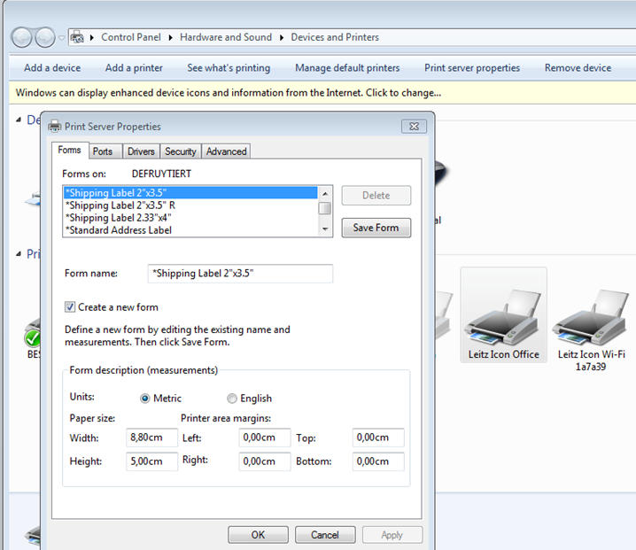
How to Add a Custom Label Size to the Drivers
1
Go to Devices & Printers. Select your Leitz Icon Printer and open the “Print Server Properties” menu.
Create a new Form
Select the size of the label you want to print. Note that the width needs to correspond the label widths we have available (12, 19, 25, 39, 50, 61 or 88mm). As the printer will cut the label to size, you can select any Height of label you desire.
As you start creating a new form from an existing one, don’t forget to rename before you click “OK”
4
2
3

